Slide 1
Empreendedorismo em ciências
2019/2020
1º CICLO DE ESTUDOS
AULA 12
09 & 12 DEZ 2019
Helena Vieira
Copyright ©

Slide 2
SUMMARY
2º PITCH I2B (5 min)
Delivery of all different versions of BMC and all materials produced during the semester for I2B projects.
Conclusion and take home message of the course.

Slide 3
I2B
2º PITCH I2B
5 min

Slide 4
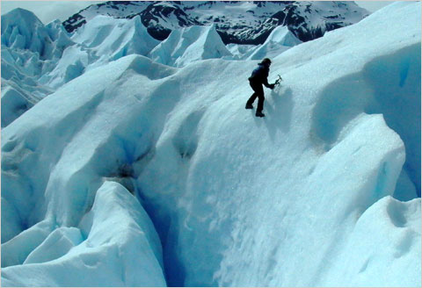
EMPREENDER
Triste de quem vive em casa
Contente com o seu lar
Sem que um sonho, no erguer de asa
Faça até mais rubra a brasa
Da lareira a abandonar
(Fernando Pessoa)

Slide 5
YOU WILL FIND MANY ”NAY SAYERS” in YOUR LIFE….
SO, BE PREPARED AND KEEP UP YOUR OWN WAY!

Slide 7
YOU ARE AT THE BEST STAGE OF YOUR LIFE FOR INNOVATION….
SO, THINK DIFFERENT!

Slide 8
GROW YOURSELF & YOUR CAPACITIES

Slide 9
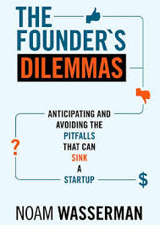

Slide 10
PODCASTS

Slide 11
NETWORK

Slide 12
NETWORK

Slide 13
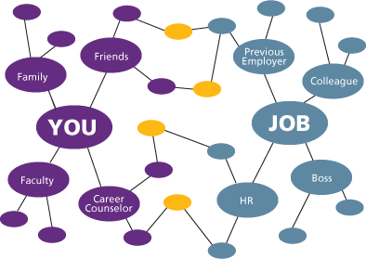

Slide 14
TRY NEW THINGS! CHALLENGE YOURSELF!

Slide 15
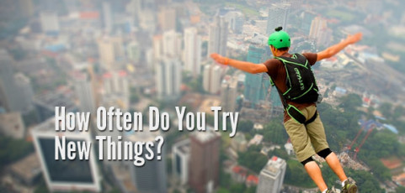

Slide 16
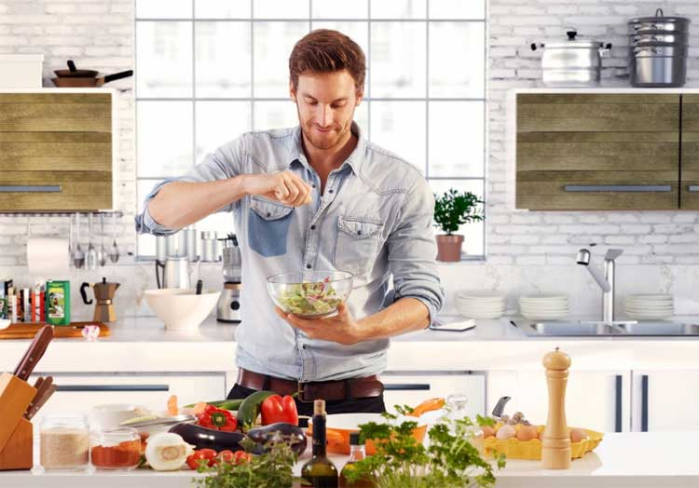

Slide 18
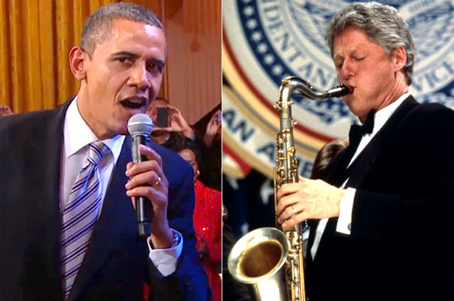

Slide 19
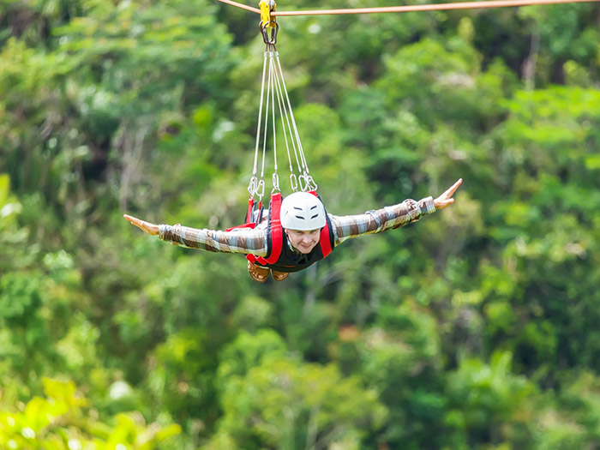

Slide 20
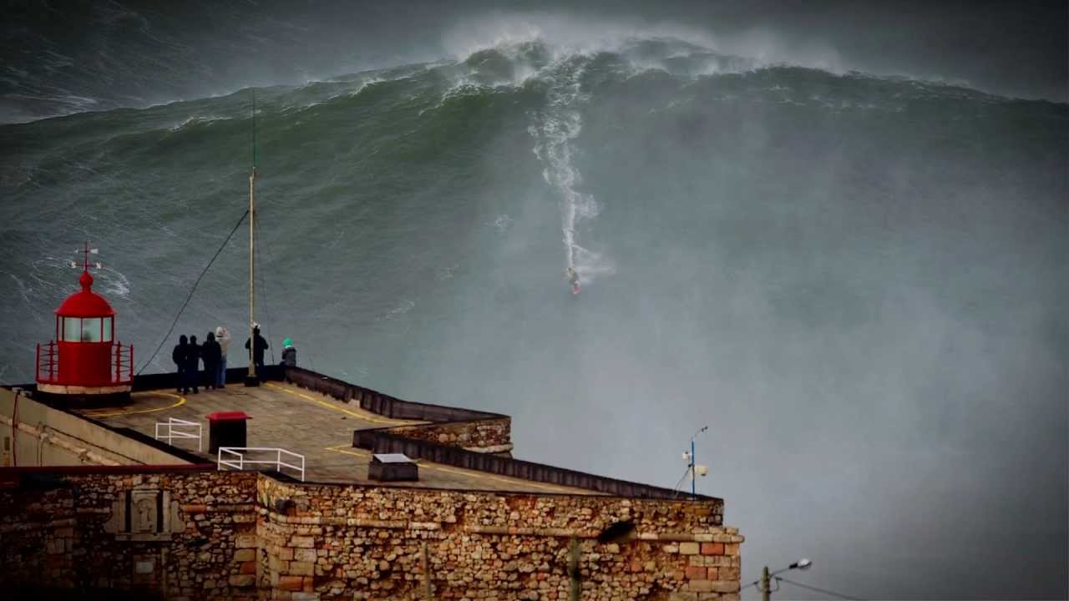

Slide 21
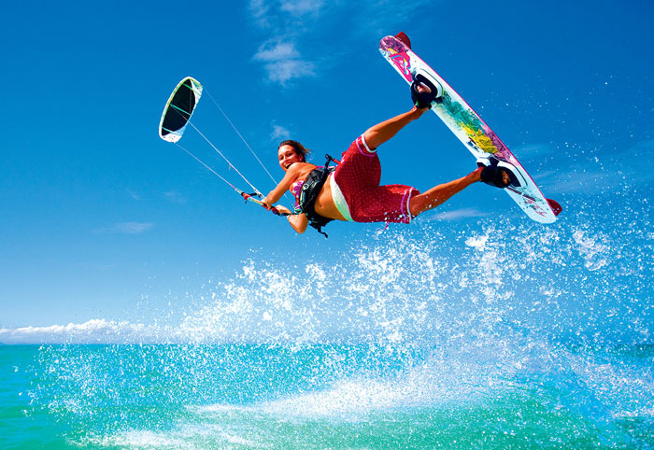

Slide 22
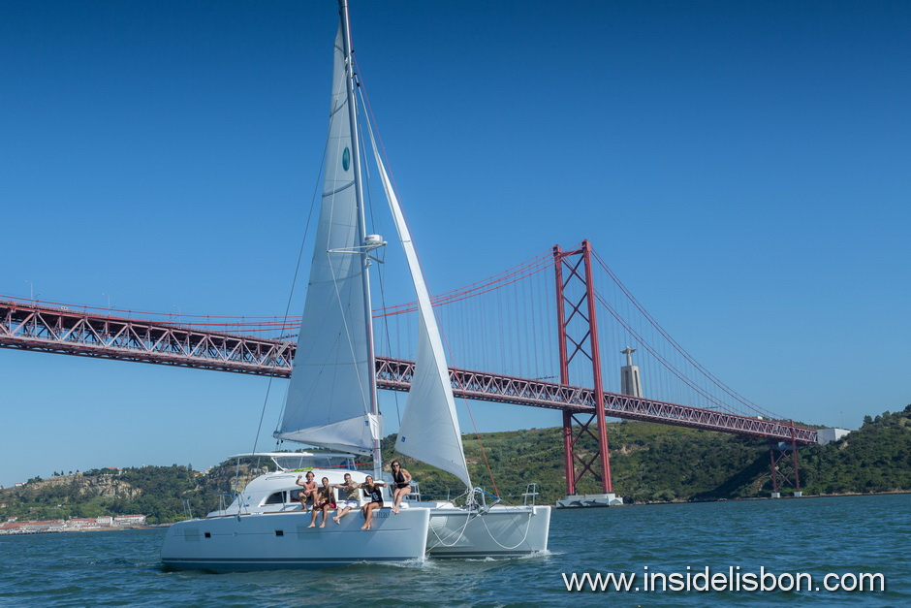

Slide 23
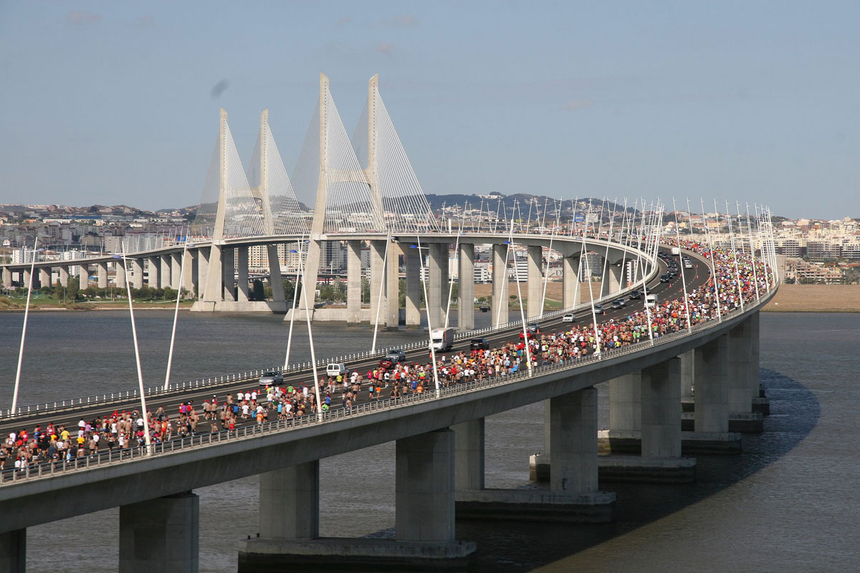

Slide 24
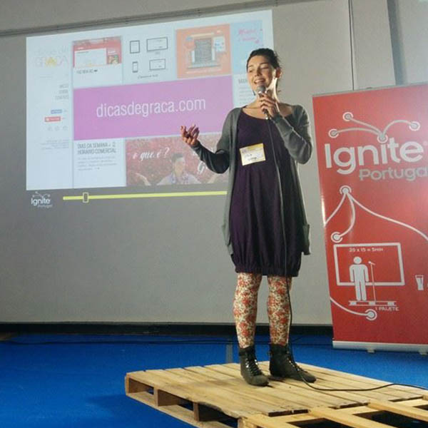

Slide 27
To deliver ON GOOGLE DRIVE FOLDER:
BM CANVAS (ALL VERSIONS)
I2B Presentations
Hypothesis Tested
FORMS & ANSWERS & INTERVIEWS
ALL EXTRAS… (facebook pages, insta, websites, landingpages, adds, etc...)

Slide 28
THANK YOU!
HELENA VIEIRA
Faculty of Sciences, University of Lisbon
hmvieira@ciencias.ulisboa.pt

